Slide 1
External Sorting
Notes:
1
The slides for this text are organized into chapters. This lecture covers Chapter 11.
Chapter 1: Introduction to Database Systems
Chapter 2: The Entity-Relationship Model
Chapter 3: The Relational Model
Chapter 4 (Part A): Relational Algebra
Chapter 4 (Part B): Relational Calculus
Chapter 5: SQL: Queries, Programming, Triggers
Chapter 6: Query-by-Example (QBE)
Chapter 7: Storing Data: Disks and Files
Chapter 8: File Organizations and Indexing
Chapter 9: Tree-Structured Indexing
Chapter 10: Hash-Based Indexing
Chapter 11: External Sorting
Chapter 12 (Part A): Evaluation of Relational Operators
Chapter 12 (Part B): Evaluation of Relational Operators: Other Techniques
Chapter 13: Introduction to Query Optimization
Chapter 14: A Typical Relational Optimizer
Chapter 15: Schema Refinement and Normal Forms
Chapter 16 (Part A): Physical Database Design
Chapter 16 (Part B): Database Tuning
Chapter 17: Security
Chapter 18: Transaction Management Overview
Chapter 19: Concurrency Control
Chapter 20: Crash Recovery
Chapter 21: Parallel and Distributed Databases
Chapter 22: Internet Databases
Chapter 23: Decision Support
Chapter 24: Data Mining
Chapter 25: Object-Database Systems
Chapter 26: Spatial Data Management
Chapter 27: Deductive Databases
Chapter 28: Additional Topics

Slide 2
Why Sort?
A classic problem in computer science!
Data requested in sorted order
  e.g., find students in increasing gpa order
Sorting is first step in bulk loading B+ tree index.
Sorting useful for eliminating duplicate copies in a collection of records (Why?)
Sort-merge join algorithm involves sorting.
Problem: sort 1Gb of data with 1Mb of RAM.
  why not virtual memory?
Notes:
4

Slide 3
2-Way Sort: Requires 3 Buffers
Pass 1: Read a page, sort it, write it.
  only one buffer page is used
Pass 2, 3, …, etc.:
  three buffer pages used.
INPUT 1
OUTPUT
INPUT 2
Main memory buffers
Disk
Disk
Notes:
5

Slide 4
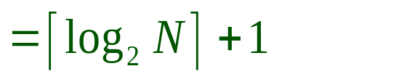
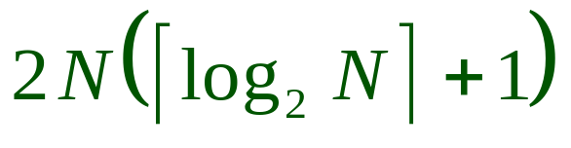
Two-Way External Merge Sort
Each pass we read + write each page in file.
N pages in the file => the number of passes
So toal cost is:
Idea: Divide and conquer: sort subfiles and merge
3,4
6,2
9,4
8,7
5,6
3,1
2
Input file
PASS 0
3,4
2,6
4,9
7,8
5,6
1,3
2
1-page runs
PASS 1
2,3
4,7
1,3
2-page runs
4,6
8,9
5,6
2
PASS 2
2,3
4,4
1,2
4-page runs
6,7
3,5
8,9
6
PASS 3
1,2
2,3
3,4
8-page runs
4,5
6,6
7,8
9
Notes:
6

Slide 5
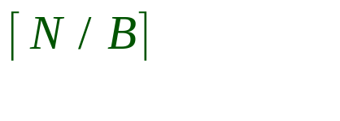
General External Merge Sort
More than 3 buffer pages. How can we utilize them?
To sort a file with N pages using B buffer pages:
  Pass 0: use B buffer pages. Produce sorted runs of B pages each.
  Pass 2, …, etc.: merge B-1 runs.
INPUT 1
. . .
INPUT 2
. . .
. . .
OUTPUT
INPUT B-1
Disk
Disk
B Main memory buffers
Notes:
7

Slide 6
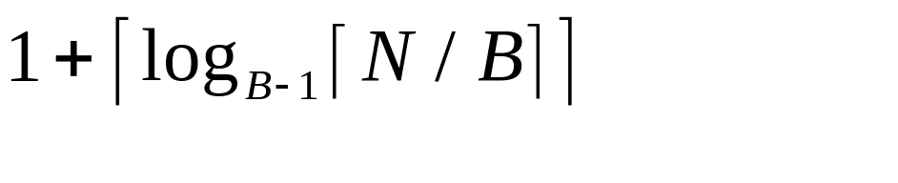
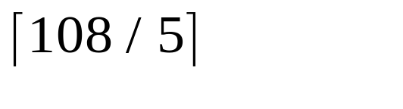
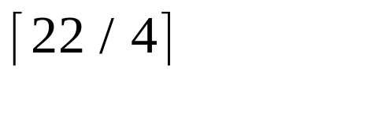
Cost of External Merge Sort
Number of passes:
Cost = 2N * (# of passes)
E.g., with 5 buffer pages, to sort 108 page file:
  Pass 0: = 22 sorted runs of 5 pages each (last run is only 3 pages)
  Pass 1: = 6 sorted runs of 20 pages each (last run is only 8 pages)
  Pass 2: 2 sorted runs, 80 pages and 28 pages
  Pass 3: Sorted file of 108 pages
Notes:
8

Slide 7
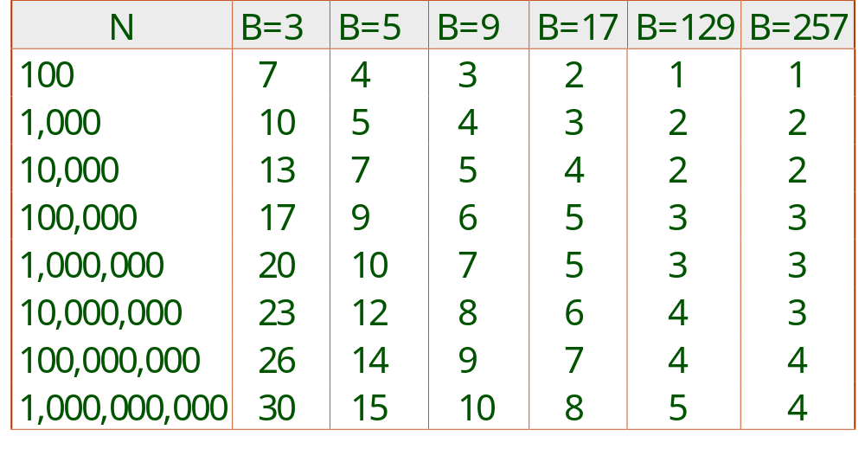
Number of Passes of External Sort
Notes:
9

Slide 8
Internal Sort Algorithm
Quicksort is a fast way to sort in memory.
An alternative is “tournament sort” (a.k.a. “heapsort”)
  Top: Read in B blocks
  Output: move smallest record to output buffer
  Read in a new record r
  insert r into “heap”
  if r not smallest, then GOTO Output
  else remove r from “heap”
  output “heap” in order; GOTO Top
Notes:
10

Slide 9
More on Heapsort
Fact: average length of a run in heapsort is 2B
  The “snowplow” analogy
Worst-Case:
  What is min length of a run?
  How does this arise?
Best-Case:
  What is max length of a run?
  How does this arise?
Quicksort is faster, but ...
B

Slide 10
I/O for External Merge Sort
… longer runs often means fewer passes!
Actually, do I/O a page at a time
In fact, read a block of pages sequentially!
Suggests we should make each buffer (input/output) be a block of pages.
  But this will reduce fan-out during merge passes!
  In practice, most files still sorted in 2-3 passes.

Slide 11
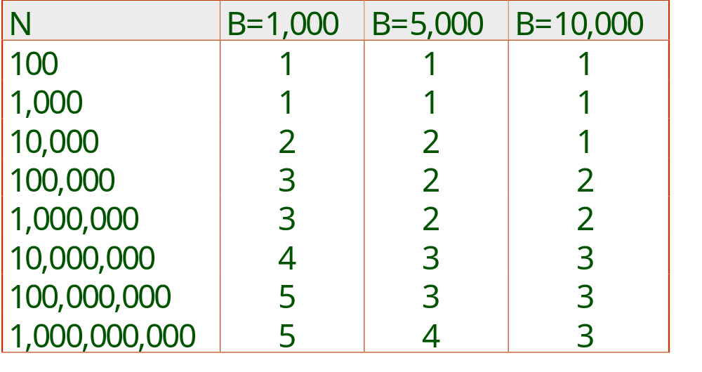
Number of Passes of Optimized Sort
Block size = 32, initial pass produces runs of size 2B.
Notes:
13

Slide 12
Double Buffering
To reduce wait time for I/O request to complete, can prefetch into `shadow block’.
  Potentially, more passes; in practice, most files still sorted in 2-3 passes.
INPUT 1
INPUT 1'
INPUT 2
OUTPUT
INPUT 2'
OUTPUT'
b
Disk
INPUT k
block size
Disk
INPUT k'
B main memory buffers, k-way merge

Slide 13
Sorting Records!
Sorting has become a blood sport!
  Parallel sorting is the name of the game ...
Datamation: Sort 1M records of size 100 bytes
  Typical DBMS: 15 minutes
  World record: 3.5 seconds
    12-CPU SGI machine, 96 disks, 2GB of RAM
New benchmarks proposed:
  Minute Sort: How many can you sort in 1 minute?
  Dollar Sort: How many can you sort for $1.00?

Slide 14
Using B+ Trees for Sorting
Scenario: Table to be sorted has B+ tree index on sorting column(s).
Idea: Can retrieve records in order by traversing leaf pages.
Is this a good idea?
Cases to consider:
  B+ tree is clustered Good idea!
  B+ tree is not clustered Could be a very bad idea!
Notes:
15

Slide 15
Clustered B+ Tree Used for Sorting
Cost: root to the left-most leaf, then retrieve all leaf pages (Alternative 1)
If Alternative 2 is used? Additional cost of retrieving data records: each page fetched just once.
Index
(Directs search)
Data Entries
("Sequence set")
Data Records
Always better than external sorting!
Notes:
16

Slide 16
Unclustered B+ Tree Used for Sorting
Alternative (2) for data entries; each data entry contains rid of a data record. In general, one I/O per data record!
Index
(Directs search)
Data Entries
("Sequence set")
Data Records
Notes:
17

Slide 17
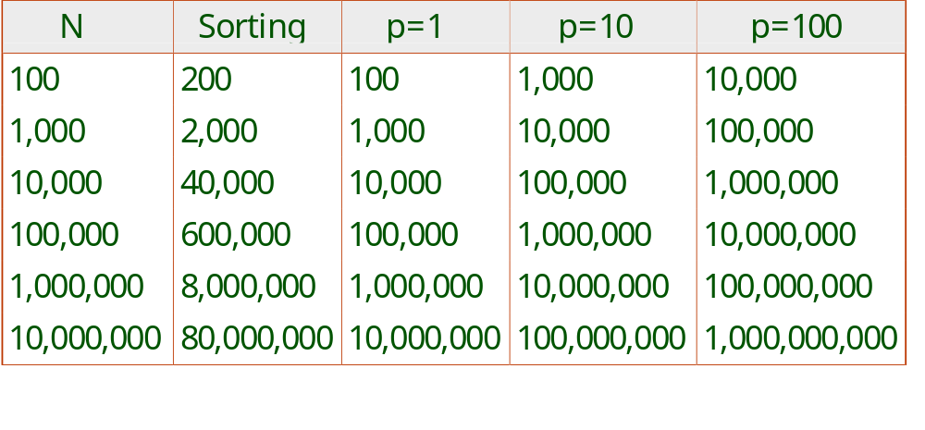
External Sorting vs. Unclustered Index
p: # of records per page
B=1,000 and block size=32 for sorting
p=100 is the more realistic value.
Notes:
18

Slide 18
Summary
External sorting is important; DBMS may dedicate part of buffer pool for sorting!
External merge sort minimizes disk I/O cost:
  Pass 0: Produces sorted runs of size B (# buffer pages). Later passes: merge runs.
  # of runs merged at a time depends on B, and block size.
  Larger block size means less I/O cost per page.
  Larger block size means smaller # runs merged.
  In practice, # of runs rarely more than 2 or 3.
Notes:
19

Slide 19
Summary, cont.
Choice of internal sort algorithm may matter:
  Quicksort: Quick!
  Heap/tournament sort: slower (2x), longer runs
The best sorts are wildly fast:
  Despite 40+ years of research, we’re still improving!
Clustered B+ tree is good for sorting; unclustered tree is usually very bad.

Slide 20
Homework
Problem 1. Read the paper:
  External memory algorithms and data structures: dealing with massive data.
  Survey by Jeff Vitter at Duke Univ.
  Www.cs.duke.edu/~jsv/Papers/catalog/node38.html#Vit:I_Osurvey.
Problem 2. Describe the external memory computing model from the paper above briefly. Summarize the status of various sorting algorithms on this model.

Slide 21
Problem 3. Overcoming memory bottlenecks in suffix tree construction.
  Farach-Colton, Ferragina and Muthukrishnan
  www.cs.rutgers.edu/~muthu
  Summarize the “block streaming model” from this paper. What conclusions do they reach about sorting?

